Slide 1


Optimized Bin Packing for Cargo Loading: A Computational Approach Using Permutation and Parallelization
Team 84

Slide 2

Problem Understanding: FedEx Cargo Loading
1
Primary Requirements
2
Cost Optimization
The total weight of packages in a ULD should not exceed its weight limit. Priority packages (higher-value shipments) must be shipped without fail. All assigned packages must fit within the dimensions of their designated ULDs. Packages should not overlap spatially inside the ULDs.
The goal is to minimize the total cost, which includes: The cost of leaving economy packages behind (if necessary due to space or weight constraints). The cost of distributing priority packages across multiple ULDs, where each ULD carrying a priority package incurs an additional cost (K per ULD).

Slide 3
Tried Approaches

Slide 4
Linear Programming
Reinforcement Learning
An initial attempt to solve the problem involved using Linear Programming (LP). However, the model takes long time to execute due to the excessive number of variables created by the numerous possible package orientations. The high-dimensional space created by these orientations posed a significant computational challenge for the LP model.
Reinforcement Learning (RL) was explored as an alternative approach. While models trained on single bins with sequence and placement policies performed reasonably well, introducing multiple ULDs with an additional ULD Policy and the constraint of not missing any priority package resulted in higher cost compared to our heuristic based approach.

Slide 5
Greedy Algorithm: A Heuristic Approach
The greedy algorithm provides a practical and computationally feasible solution to the ULD optimization problem. It leverages heuristics such as height-based sorting, volume optimization, and permutation testing to generate solutions that are often close to optimal for small to medium-sized datasets. The incorporation of multiprocessing further enhances its scalability, making it suitable for real-world applications where quick and effective solutions are necessary.

Slide 6
Heuristics: Optimizing the Packing Process
Sorting Economy Packages
Greedy Selection
Economy packages are sorted by decreasing cost/volume ratio (Maximum Cost Sorting).
Select the first X economy packages (parameter X).
Run the greedy algorithm on these packages.
Vary X, record results, and return the best solution with the minimum cost.

Slide 7
Greedy Packing (X)
ULD Permutations and Rotations
For all ULD permutations (limit: 500), rotate ULDs in all three possibilities.
Choose the rotation that packs maximum boxes.
2) Package Sorting
Similar Height Sorting: Maximize packages with the same height to minimize voids.

Slide 8
Packing Process
Fill ULDs Greedily
Pick a ULD and fill boxes layer-wise till the max box limit is reached.
Use rectpack to determine the max fit for increasing box counts.
2) Priority and Economy Package Handling
Fill ULDs with priority packages first, then handle economy packages for leftover spaces.
Perform volume optimization by sorting economy packages by minimum height and volume.
3) Iterative Fitting for Economy Packages
Add packages one by one to ULDs until the max limit is reached.

Slide 9
Heuristics: Optimizing the Packing Process
Minimum Height Sorting
This heuristic aims to find a height dimension that results in the maximum number of packages with similar heights. This helps in optimizing vertical stacking and maximizing space utilization.
Cost and Volume Optimization
Prioritize most valuable packages. Packages are sorted in decreasing order of cost and increasing order of volume.
After cost opt. Leftover packages sorted in order of height and volume to use remaining space.
ULD Permutations
Evaluating different potential packing configurations. This step aims to reduce priority splits and ensure that the maximum number of packages can be packed efficiently.

Slide 10
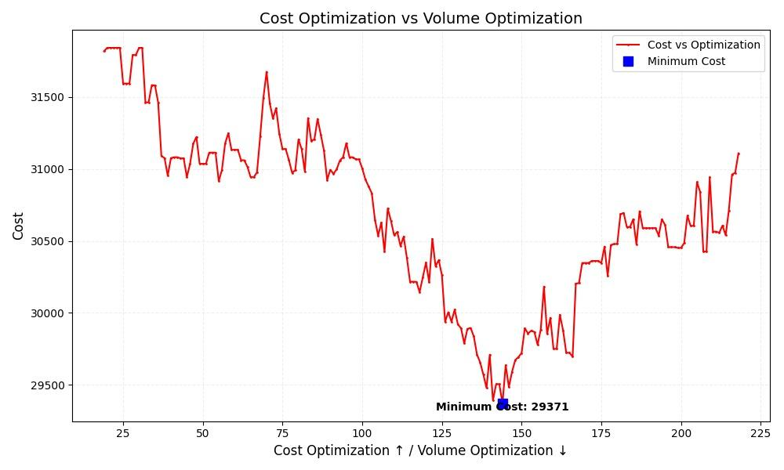
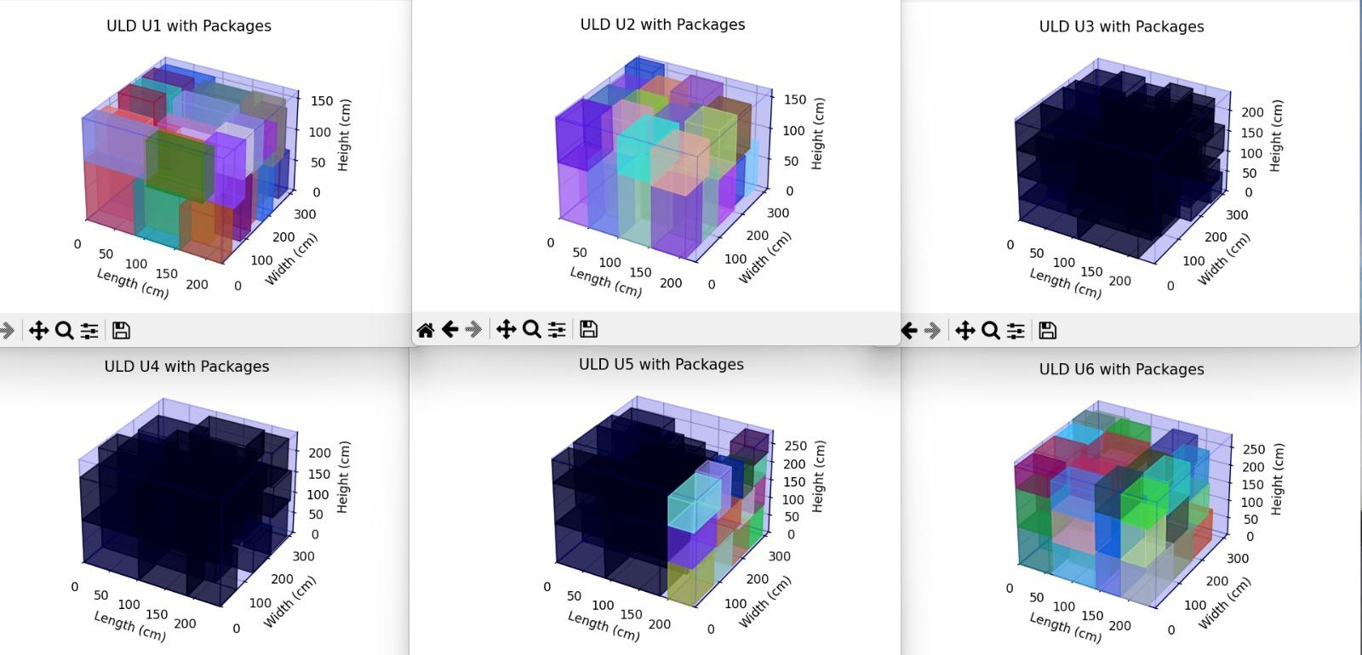
Results
The algorithm balances cost optimization (X) and volume optimization (N-X).
The method reduces priority package splitting and optimizes the total cost.
The layer-wise approach minimizes voids and ensures maximum utilization of available space.

Slide 11
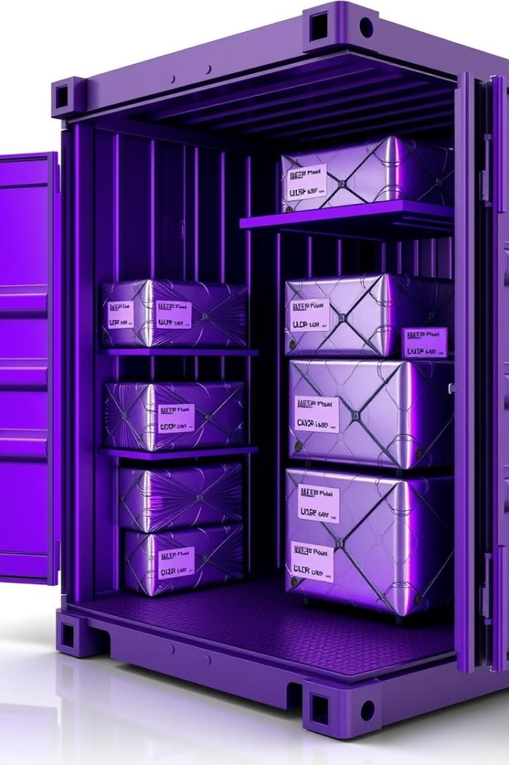
Example Computation
The following input data is provided:
ULDs (Unit Load Devices):
ULD-1: 100cm×80cm×80cm,Weight Limit: 250kg
ULD-2: 100cm×80cm×80cm,Weight Limit: 250kg
Packages:
P-1: 70cm×40cm×50cm,Wt: 100kg,Priority
P-2: 70cm×40cm×50cm,Wt: 100kg,Priority
P-3: 70cm×40cm×50cm,Wt: 150kg,Economy, Cost of Delay: 20
P-4: 70cm×40cm×50cm,Wt: 150kg,Economy, Cost of Delay: 30
Cost per ULD carrying a Priority package: K = 40

Slide 12
Step 1: Packing Results
Packed in ULD-1:
P-1 at coordinates (0,0,0) to (40,50,70)
P-2 at coordinates (40,0,0) to (80,50,70)
Packed in ULD-2:
P-4 at coordinates (0,0,0) to (40,50,70)
Unpacked:
P-3: Not packed due to weight or space constraints

Slide 13
Step 2: Void Space Calculations
For ULD-1:
Total Volume: 100 × 80 ×80 = 640,000
Packed Volume: 2 ×(70×40×50) = 280,000
Void Space: 640,000 − 280,000 = 360,000
For ULD-2:
Total Volume: 100 × 80 ×80 = 640,000
Packed Volume: 70 ×40×50 = 140,000
Void Space: 640,000 − 140,000 = 500,000

Slide 14
Step 3: Cost Optimization
Priority ULD cost:
1 ×K =1×40=40
Economy package delays (P-3 unpacked):
Cost of delay: 20
Total Cost:
Cost = 40+20 = 60

Slide 15
Step 4: Final Results
Packed Volume:
280,000 +140,000= 420,000
Void Space:
360,000 +500,000 = 860,000
Unpacked Volume:
70 ×40×50 =140,000
Total Cost = 60

Slide 16
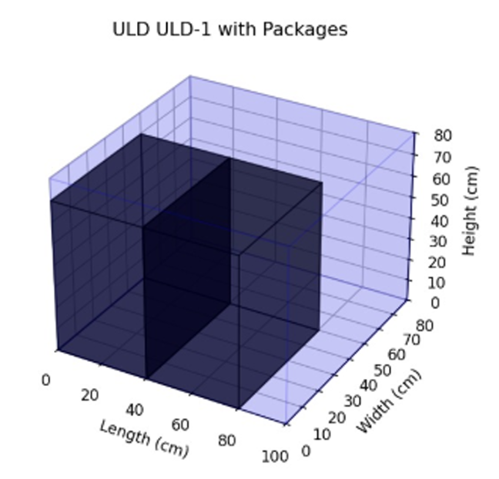
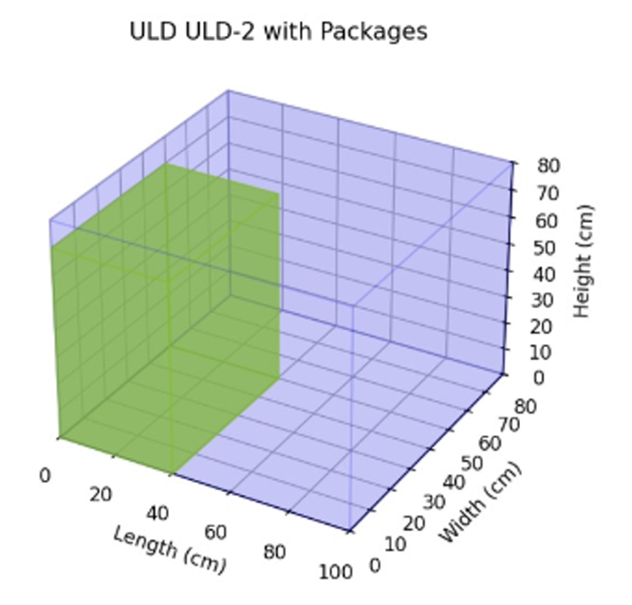
Visualization

Slide 17
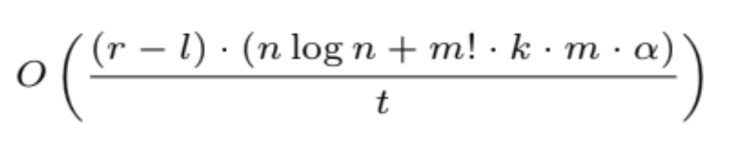
Time Complexity Analysis
r-l : Number of packet subset considered
n logn : Sorting the packages
m! : Permutation for m ULDs
k.m : Number of potential orientations
𝛼 : Worst case for rectpack packing, proportional to (Area_ULD/Area_Package)^2, which is around 1000 in our case.
t : Number of threads

Slide 18
Code Implementation Challenges
Array Size Limitations
Used NumPy for efficient 3D ULD representation, overcoming Python's array limitations.
Threading & Performance
Implemented multiprocessing to handle large datasets; managed thread safety and workload balancing.
Sorting & Filtering
Debugged complex sorting mechanisms to ensure accuracy and optimization for height and volume.

Slide 19
Optimization and Fixes
Weight Constraints
Redesigned logic for dynamic re-packing to meet ULD weight limits.
Package Orientation
Managed different orientations while adhering to volume and weight constraints.
Redundant Permutations
Eliminated similar ULD configurations to reduce computational overhead.

Slide 20

Future Directions
Consider relative weights of packages while stacking : To prevent damage from heavier packages stacked on lighter ones.
Prevent package toppling by ensuring area of packages below covers up a suitable part of the base.

Slide 21
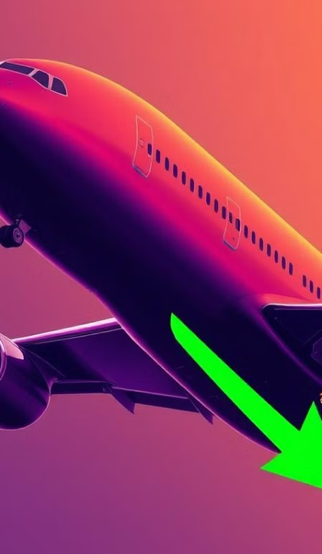
Thank You

